Slide 1
CloudCore
Day 4 – IoT Fundamentals in Azure

Slide 2


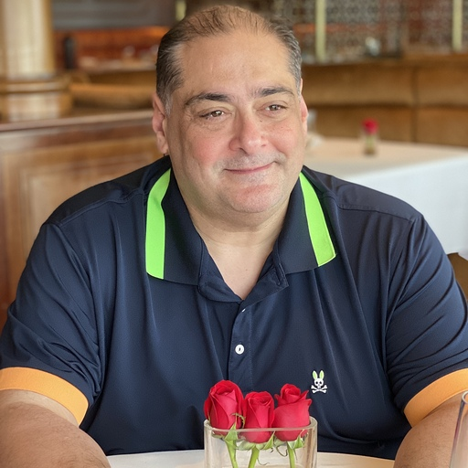
Alain "Lino" Tadros is a partner architect at Solliance on AI, Machine Learning and IoT for the last 4 years.
Lino provides world-class consulting, training, and software development for small, medium, and enterprise level businesses. Lino started his career in 1990 as a well-respected member of the development team at Borland for Delphi and C++Builder.
He has been awarded Microsoft MVP status 15 years in a row for his numerous contributions to the C# community and currently is recognized as a Microsoft Regional Director. Lino is also an expert in AI & Machine Learning, IoT, .NET, Azure, ASP.NET, MVC, iOS, Android, Xamarin, Sitefinity and many testing solutions.
Lino is an industry renowned speaker and has given numerous presentations in 53 countries since 1994. He currently sits on the Board of Directors of 4 Silicon Valley corporations.
You can regularly catch Lino on his LiveStream on Twitch at https://twitch.tv/linotadros
Lino Tadros
Cloud Solutions Architect
lino@solliance.net

Slide 3
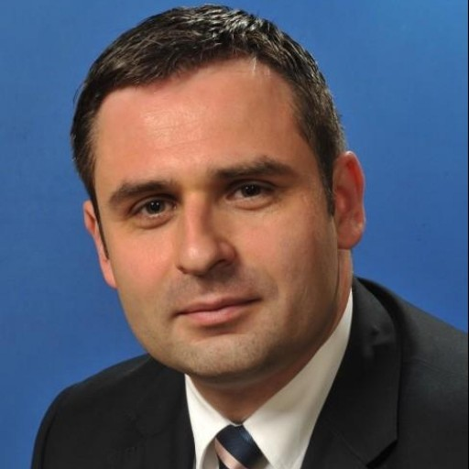
Ciprian Jichici is the Chief Data Scientist of Solliance, one of the top worldwide Microsoft AI partners.
He is recognized internationally as a Microsoft Regional Director and a Microsoft Most Valuable Professional for Artificial Intelligence and Quantum Computing.
Cloud Computing, Artificial Intelligence, and Machine Learning are some of the key areas of his expertise spanning 20+ years of IT.
Ciprian is also very passionate about quantum physics and consequently, about quantum computing.
Ciprian Jichici
Chief Data Scientist
ciprian@solliance.net

Slide 4

Day 4 Rundown
Timeframe | Activity | Engagement
7:30 – 8:00 | Virtual check-in
8:00 – 9:00 | IoT Fundamentals in Azure
9:00 – 11:15 | WDS: IoT and the Smart City | Interactive Discussion
11:15 – 12:00 | Lunch
12:00 – 14:00 | Team Challenge: IoT and the Smart City PoC | Interactive Discussion | Hands-on
14:00 – 14:15 | Wrap Up the Day

Slide 5
Day 4 – We are here
Timeframe | Activity | Engagement
7:30 – 8:00 | Virtual check-in
8:00 – 9:00 | IoT Fundamentals in Azure
9:00 – 11:15 | WDS: IoT and the Smart City | Interactive Discussion
11:15 – 12:00 | Lunch
12:00 – 14:00 | Team Challenge: IoT and the Smart City PoC | Interactive Discussion | Hands-on
14:00 – 14:15 | Wrap Up the Day

Slide 6
Agenda
Fundamental Concepts & Patterns
Fundamental Services
Machine Learning Operations
Azure Machine Learning

Slide 7
Fundamental Concepts & Patterns

Slide 8
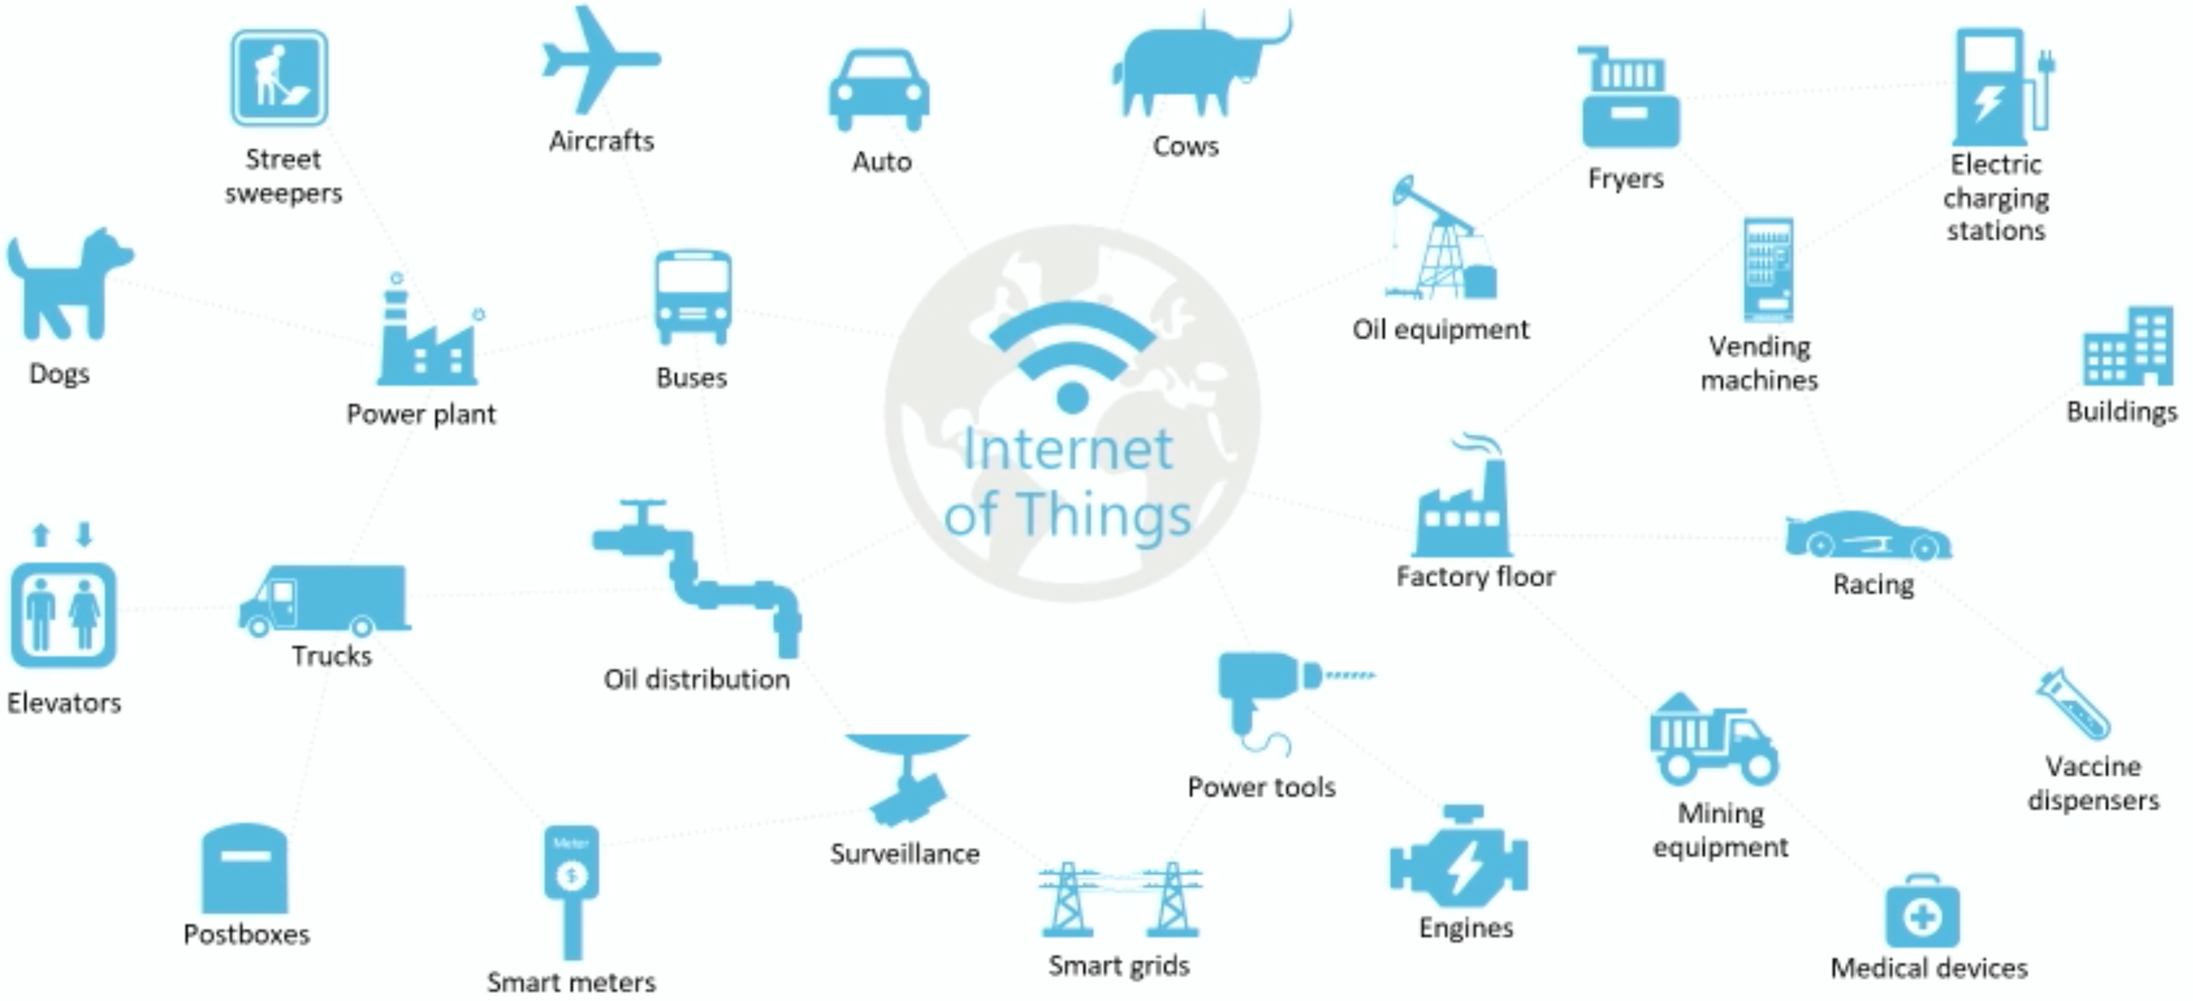
“When wireless is perfectly applied, the whole earth will be converted into a huge brain, which in fact it is, all things being particles of a real and rhythmic whole…”
Nicola Tesla, 1926

Slide 9
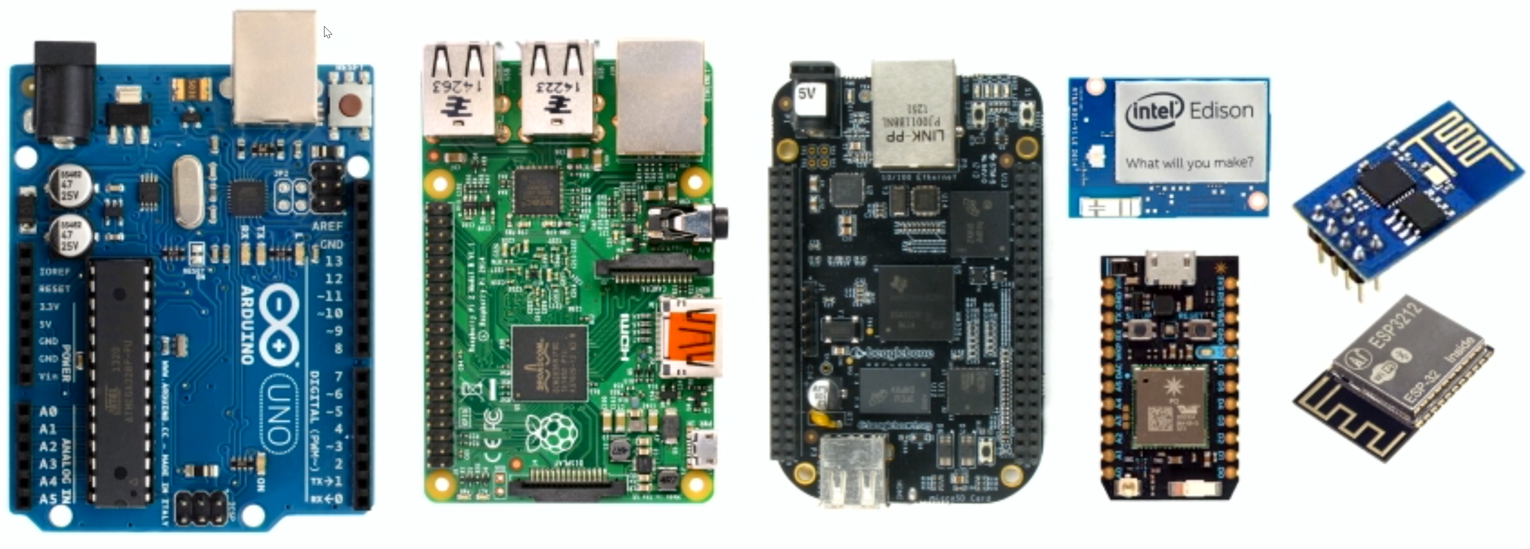
Devices

Slide 10
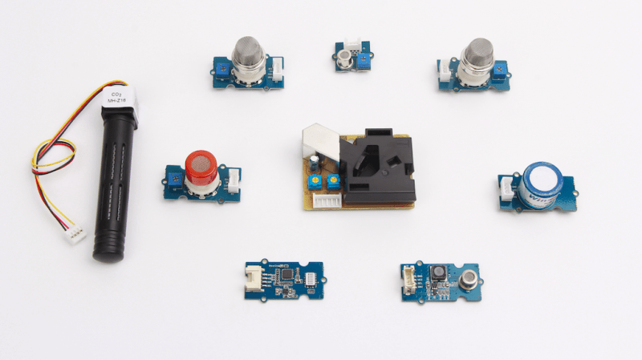
Sensors

Slide 11
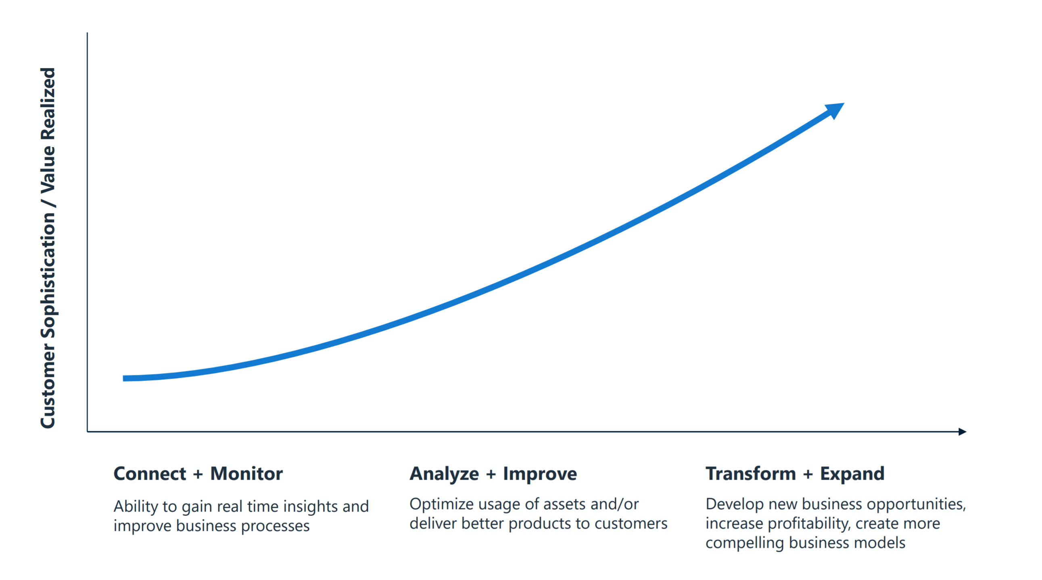
IoT market maturity model

Slide 12
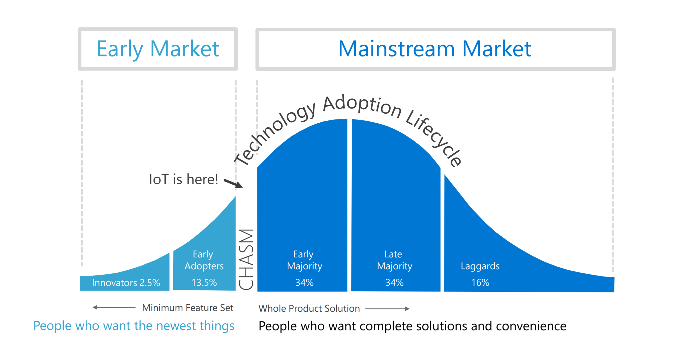
Crossing the chasm

Slide 13
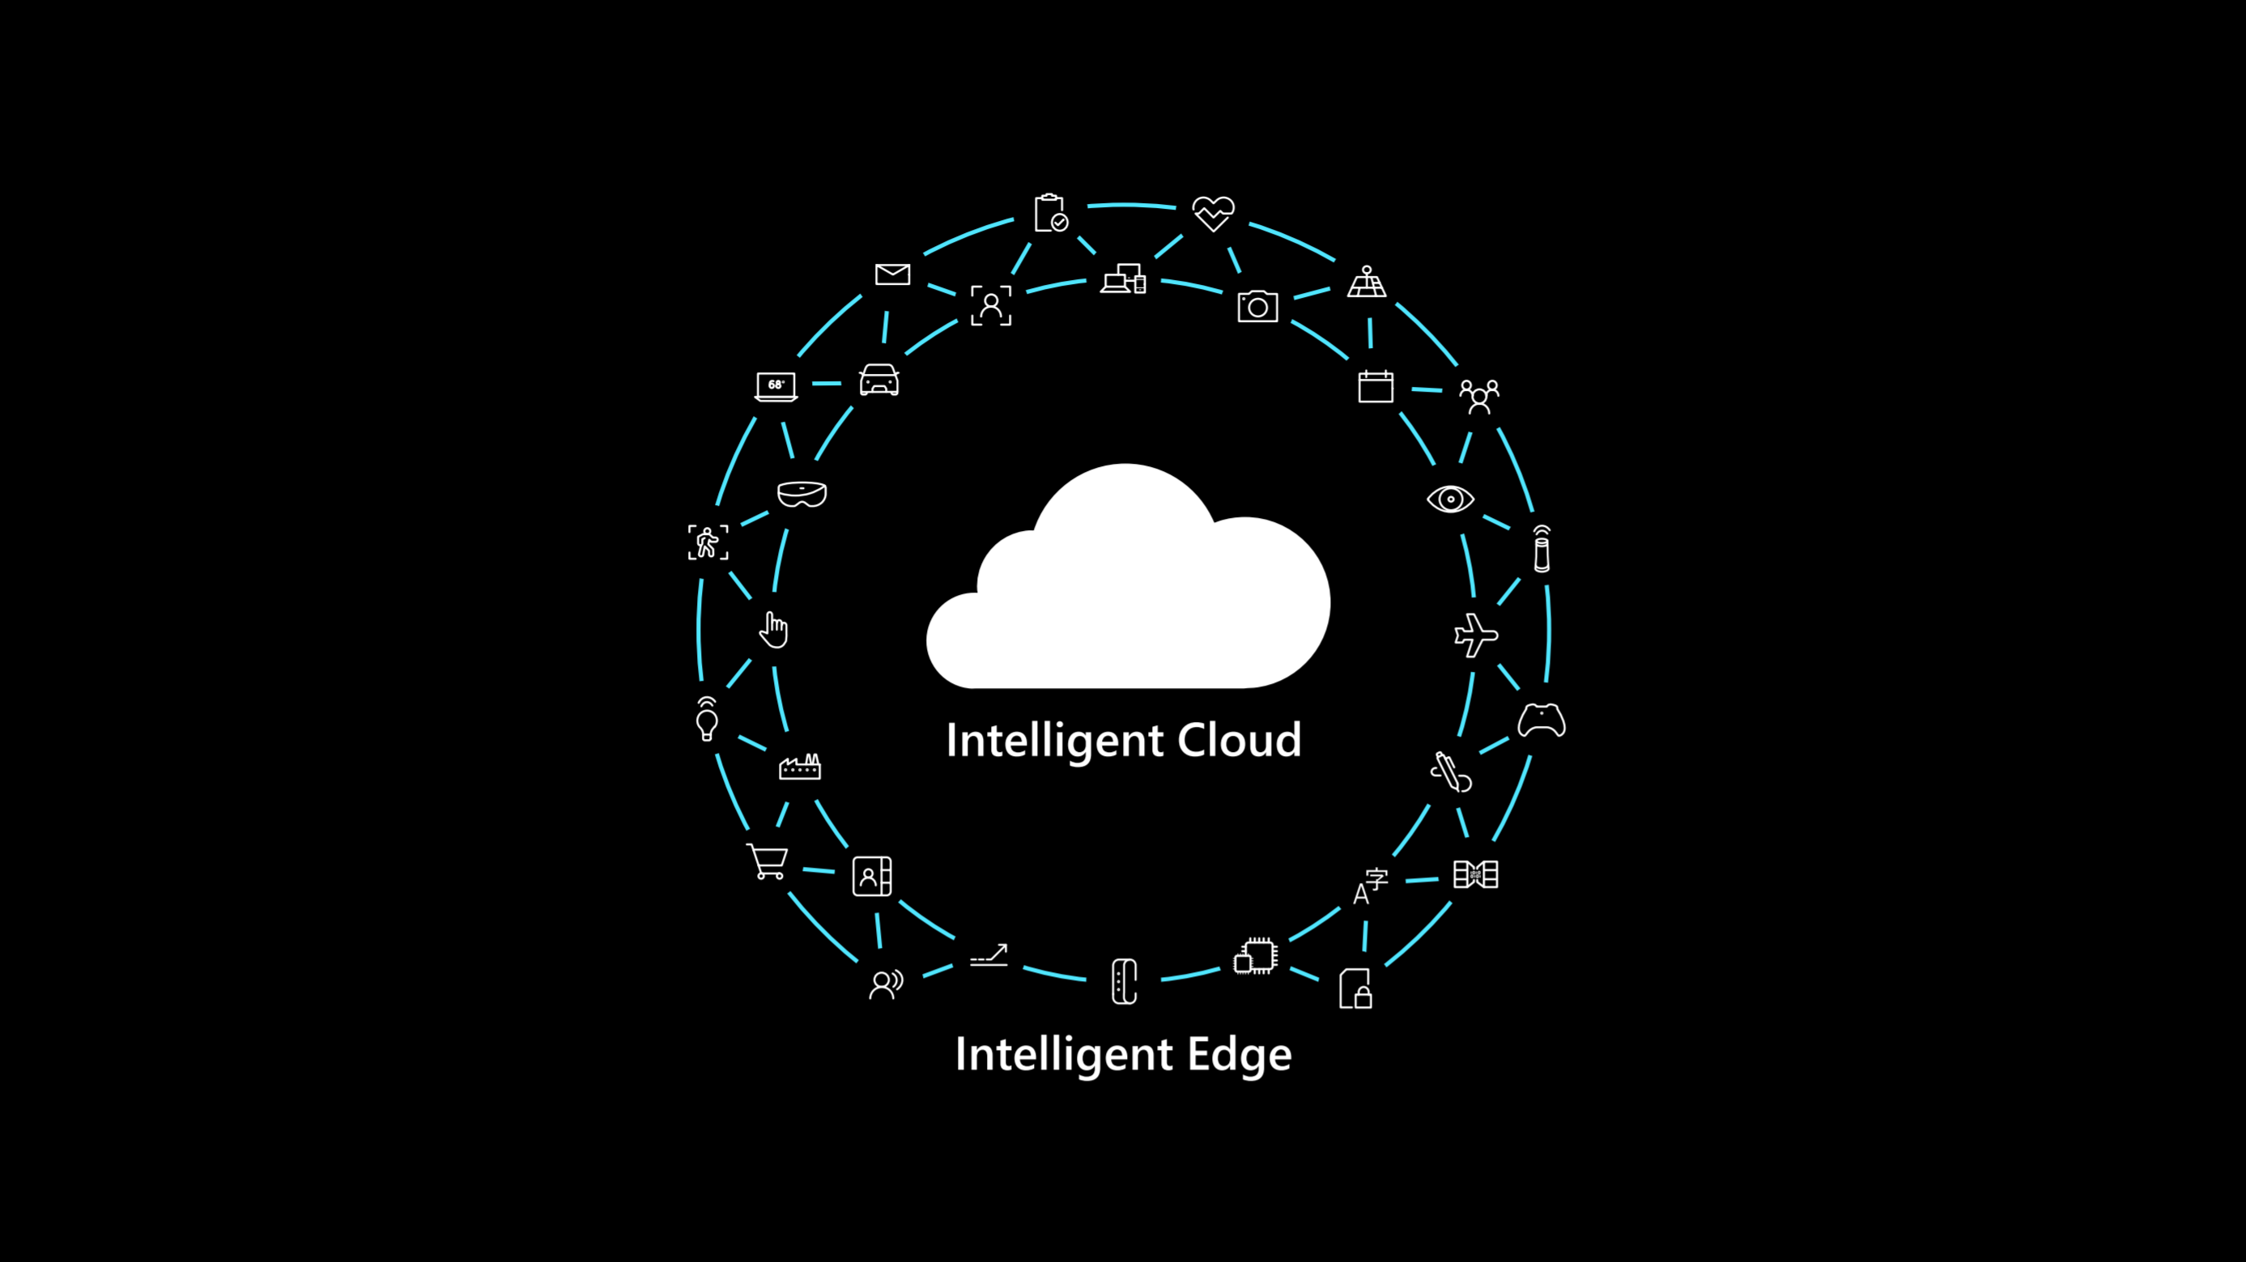
Crossing the chasm

Slide 14
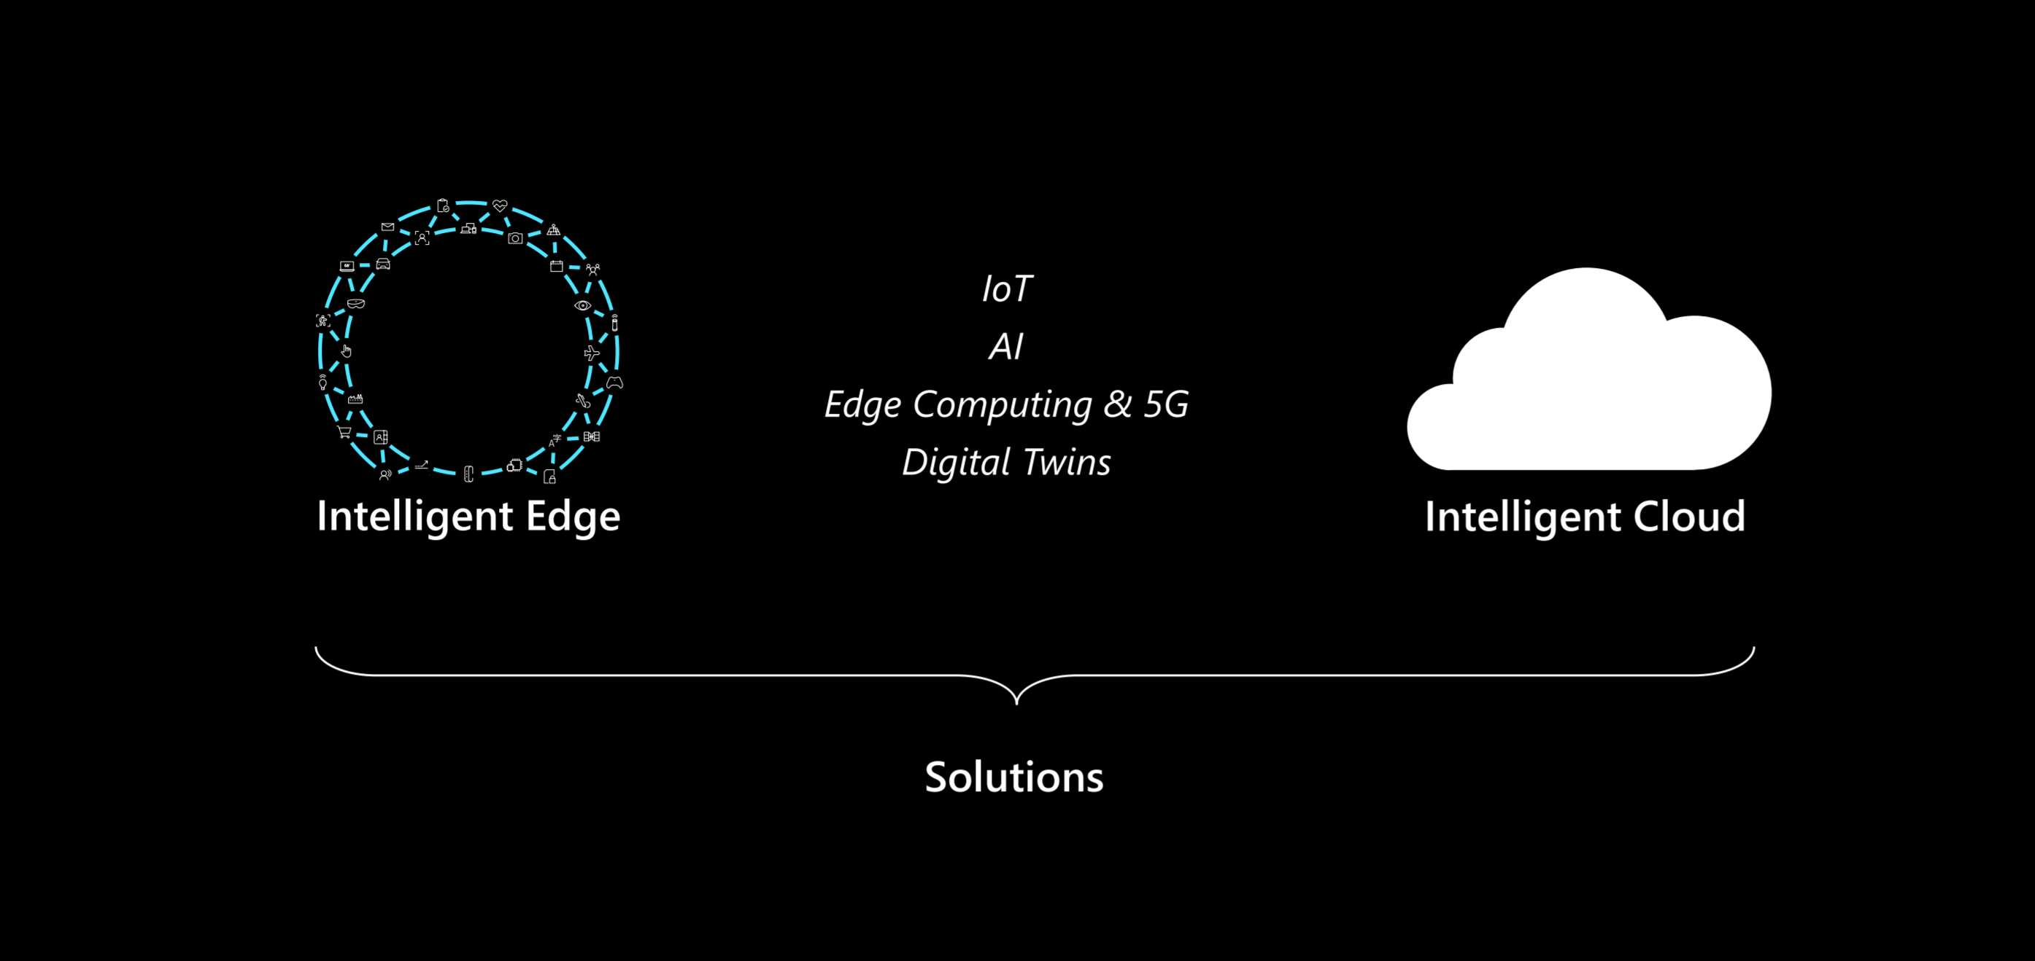
Solutions that span edge to cloud

Slide 15
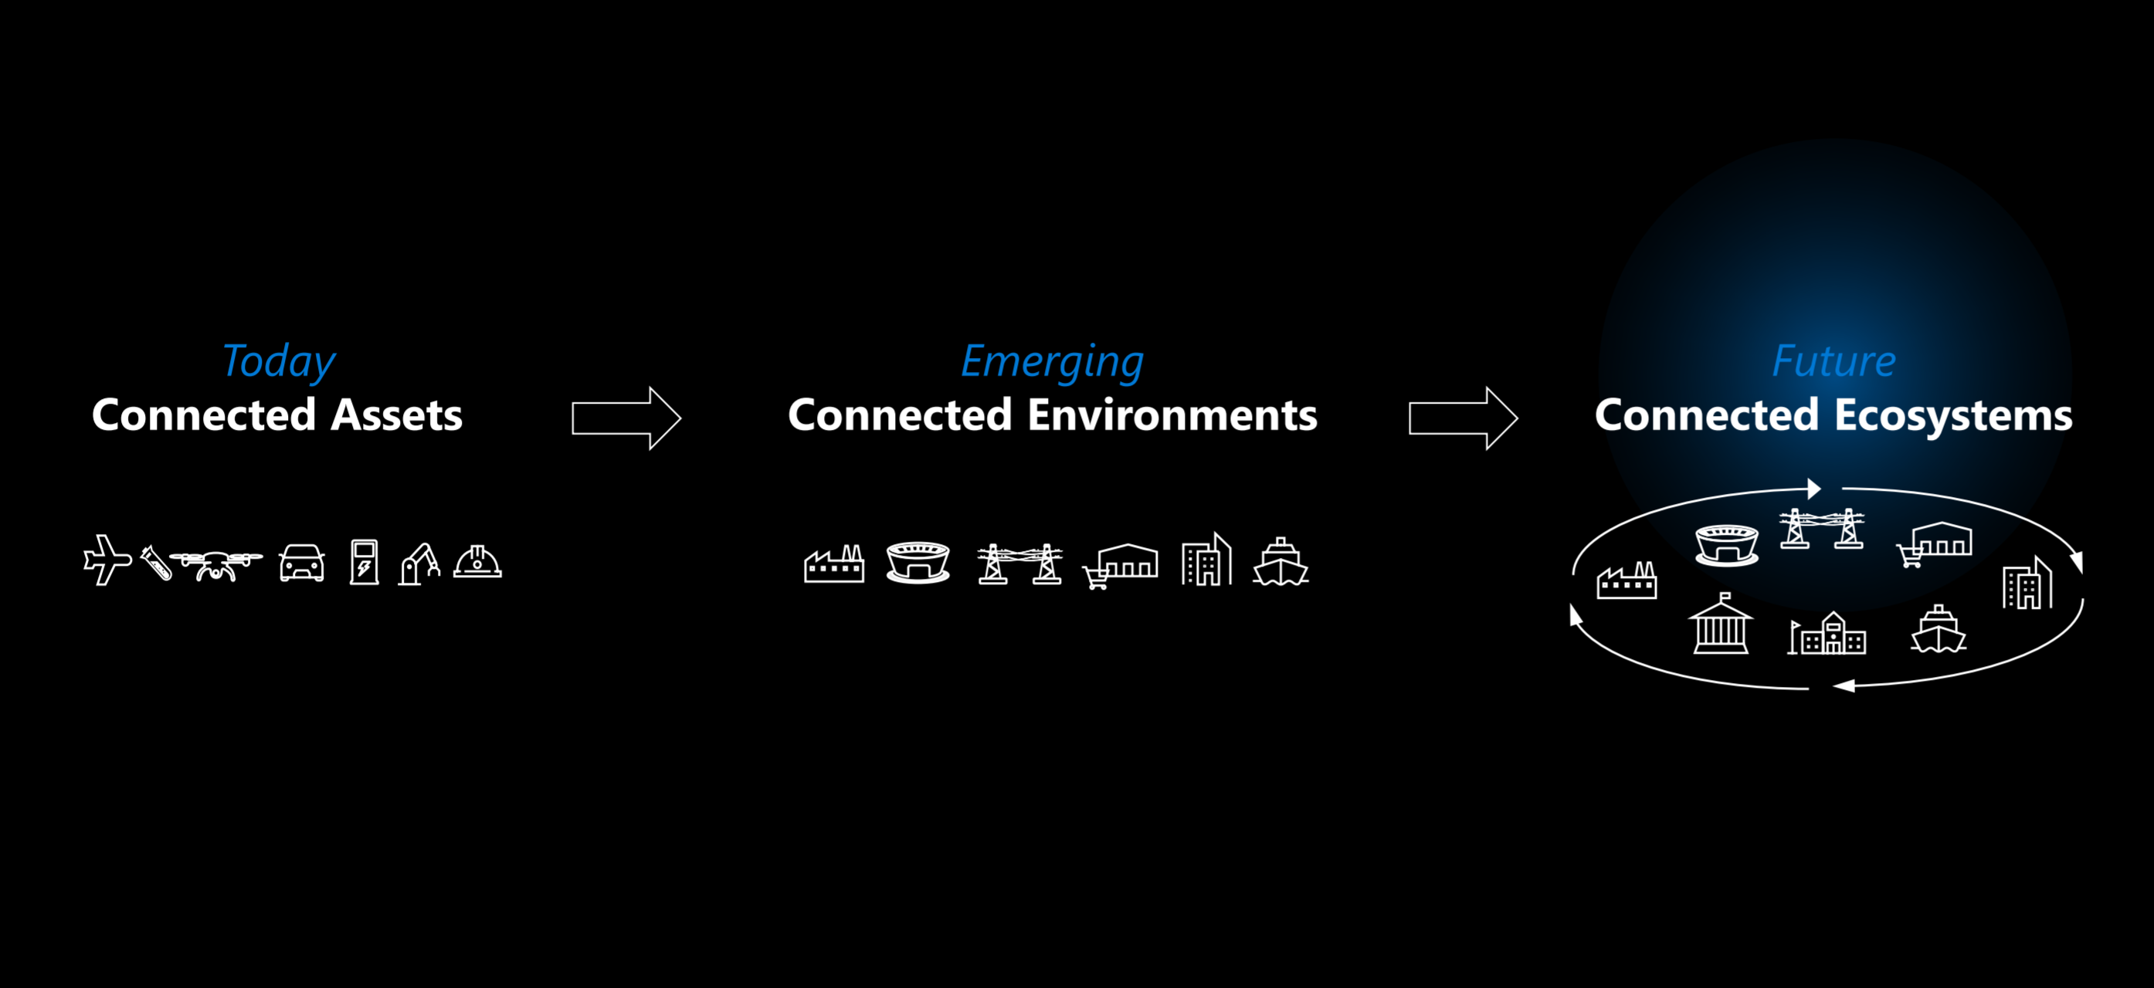
The evolution of connected solutions

Slide 16
Fundamental Services

Slide 17
Today Connected Assets

Slide 18
End-to-end edge platform
a
b
c
d
Microsoft Azure
Azure Sphere
Drone
Industrial
Assets
Azure Data Box Edge
Azure Stack
Azure IoT Edge
Azure Services
Tools
Consistent security, identity, management & AI, partner ecosystem

Slide 19
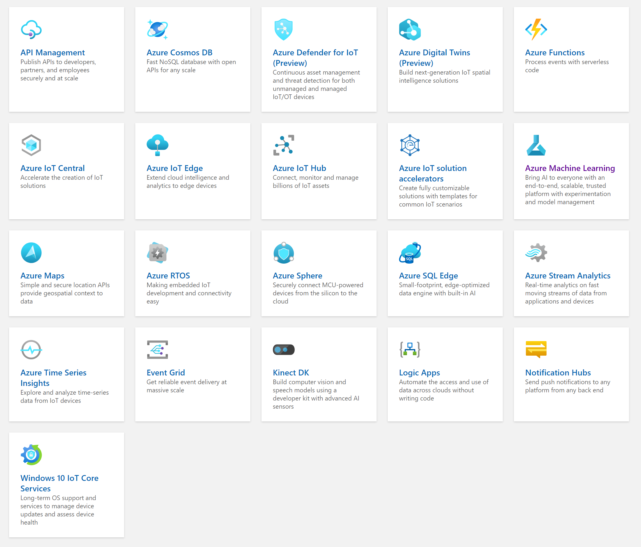
Internet of Things

Slide 20
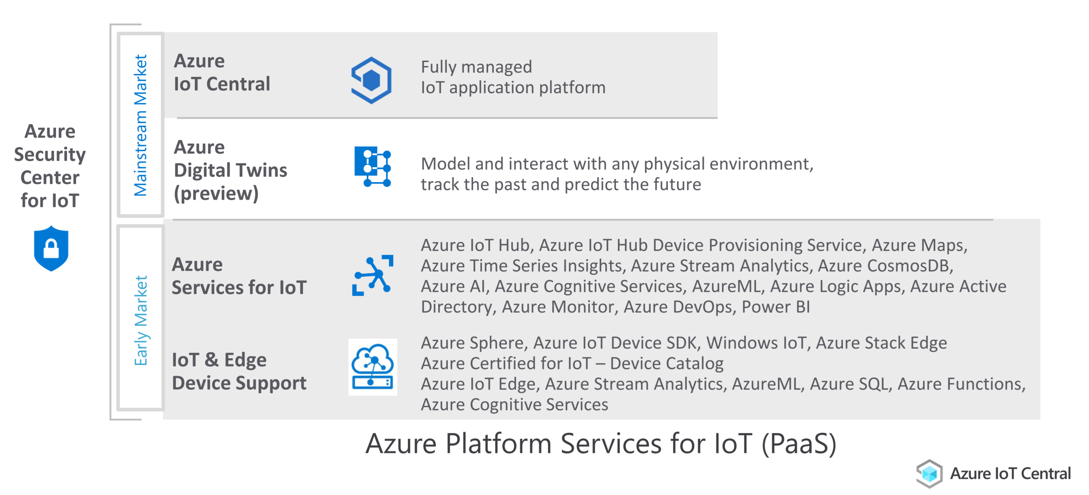
Well-composed entry points for IoT solutions

Slide 21
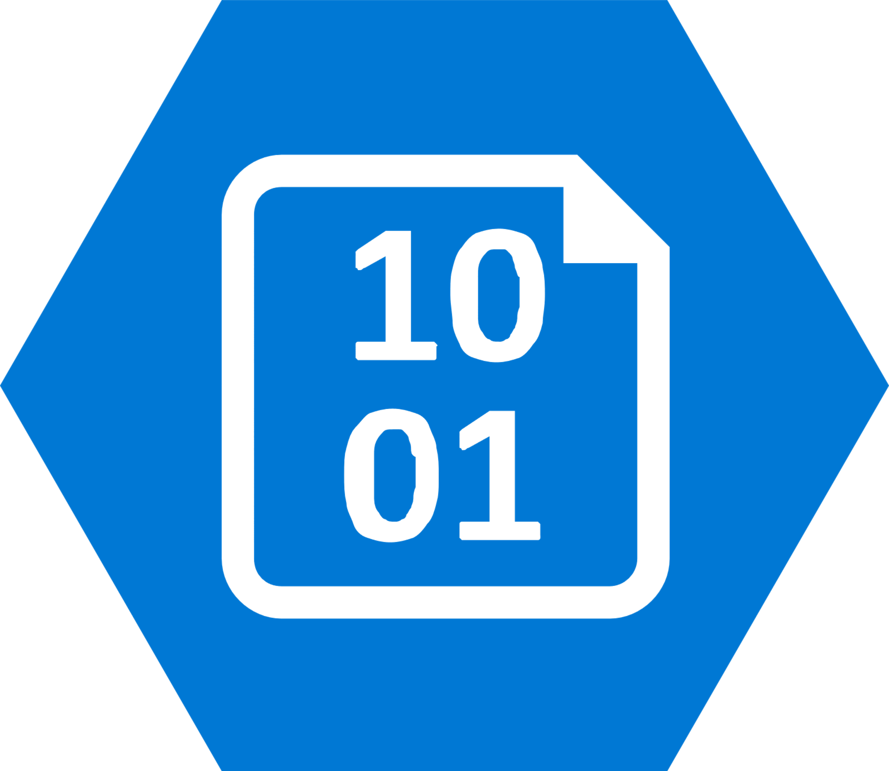

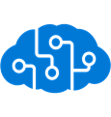

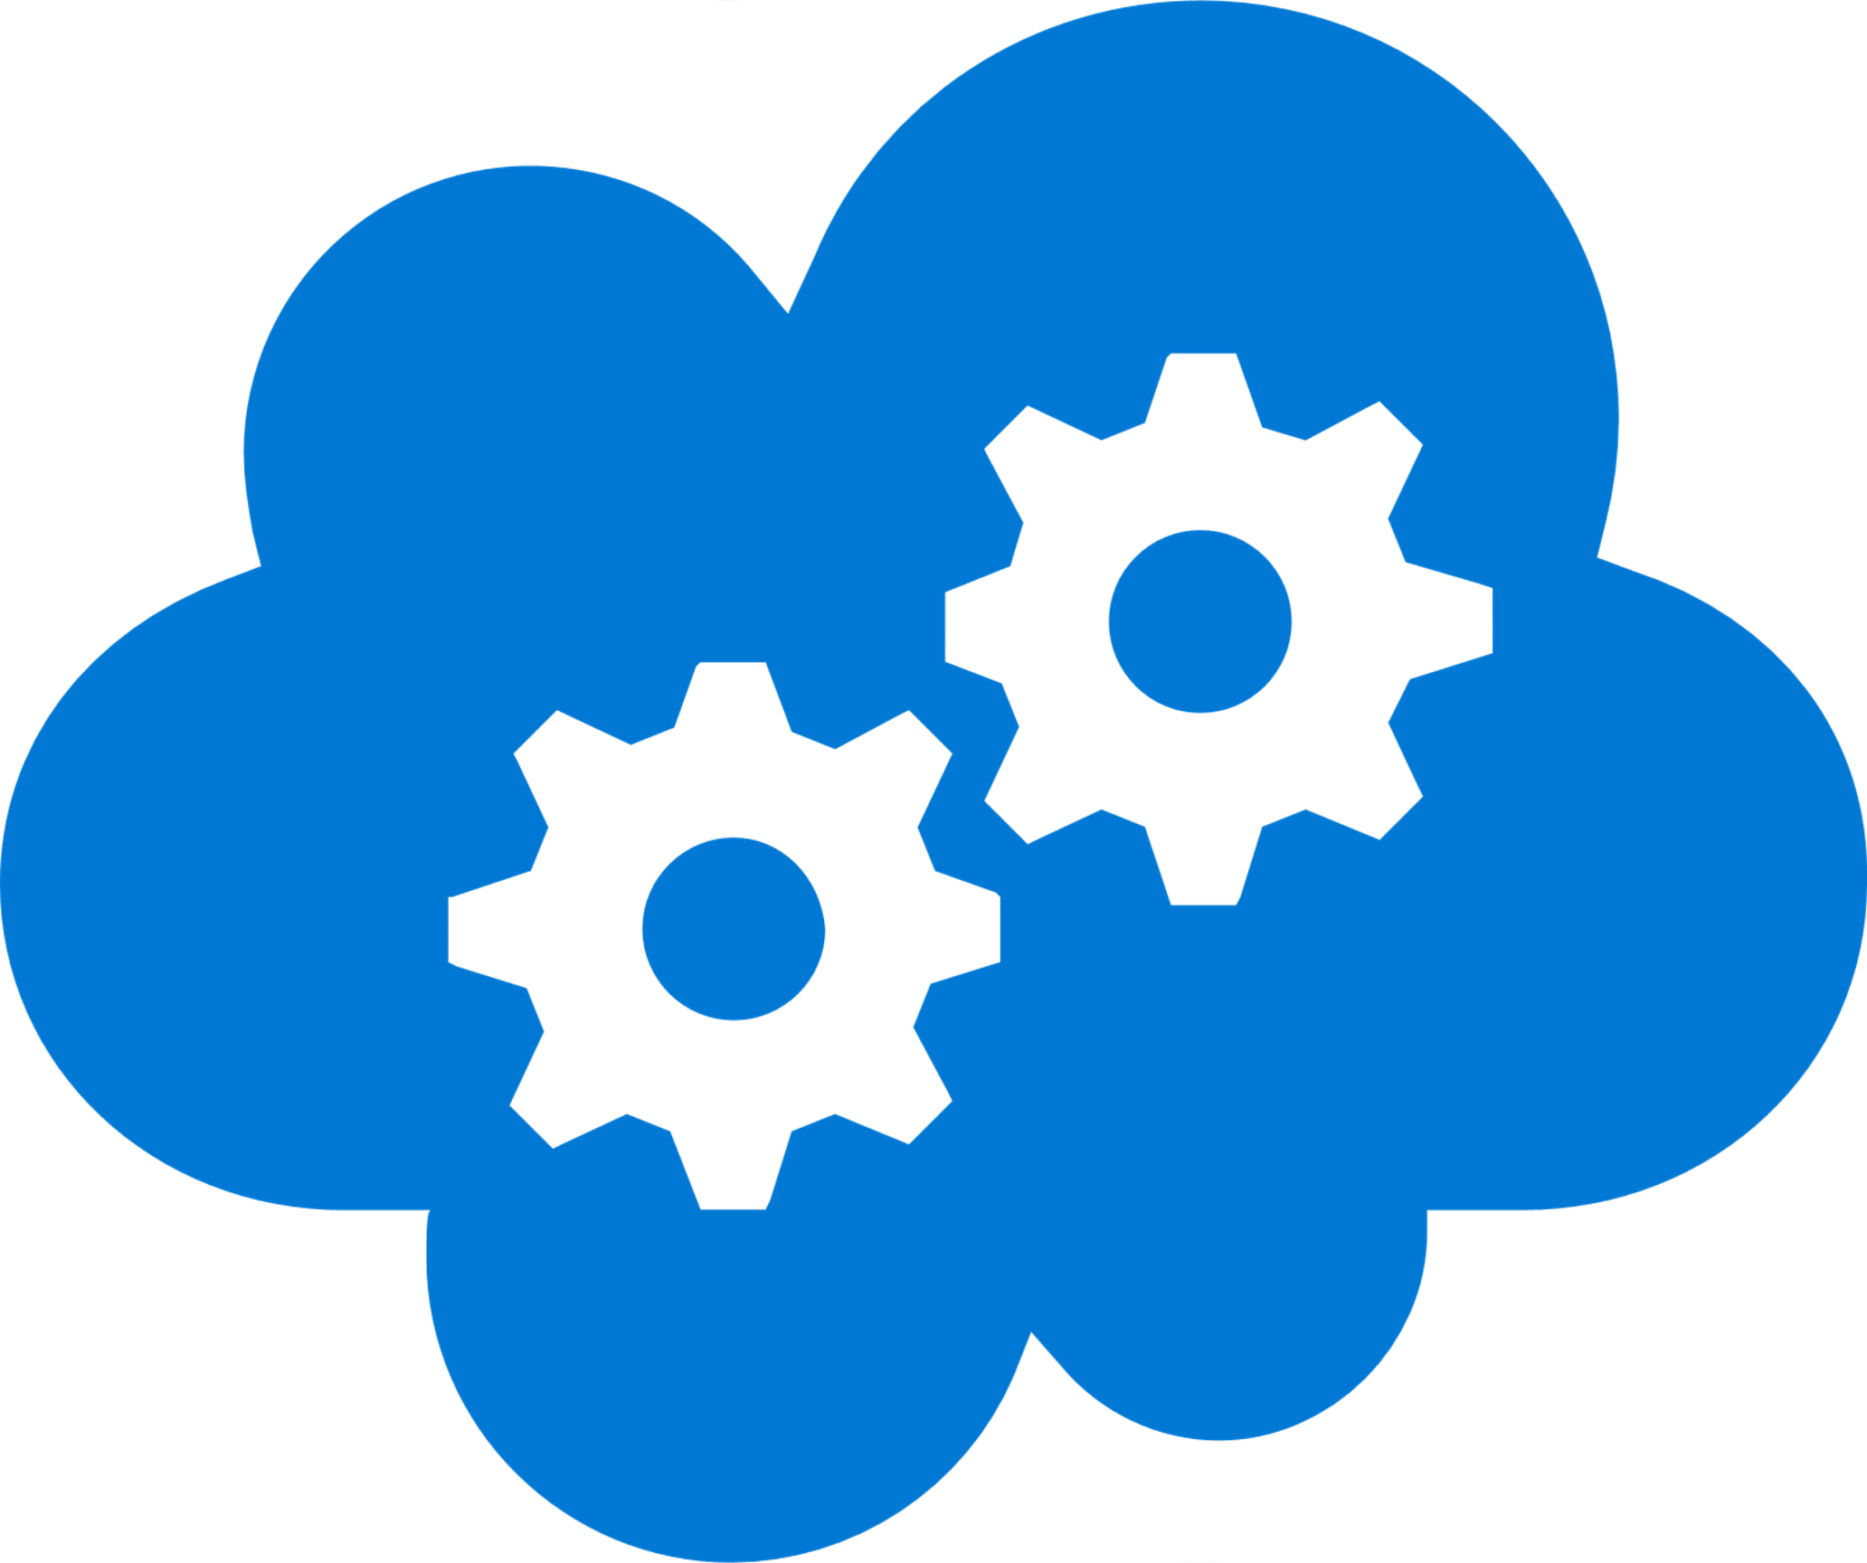
Azure Stack
Complete autonomous cloud
Only consistent hybrid cloud that can run at the connected or disconnected
Edge & Disconnected
Cloud application model
Common application model, tools and APIs with Azure simplifying DevOps
Regulatory & Data Sovereignty
Azure Services & Marketplace
Azure web services, containers, Azure Functions, & Azure Marketplace
Application Modernization
Integrated System
cloud inspired infrastructure via integrated systems from major H/W partners

Slide 22
Azure Stack
Azure Stack is an extension of the Azure platform
It brings the agility and innovation of cloud computing to on-premises environments
Organizations can build modern applications across hybrid cloud environments with the right flexibility and control
Consistent…
Tools and experiences
Portal | PowerShell | DevOps tools | More
Easily transfer your skills and processes between Azure clouds while using the tools you want
Cloud application model
Azure Resource Manager
Manage your cloud resources the same way everywhere
Azure Services and Marketplace
Compute | Networking | Storage |
App Service | Functions | More…
Get what you need when you need it with true cloud services on-premises
Cloud infrastructure
Integrated system design
Go faster, safely with a cloud inspired infrastructure via integrated systems

Slide 23
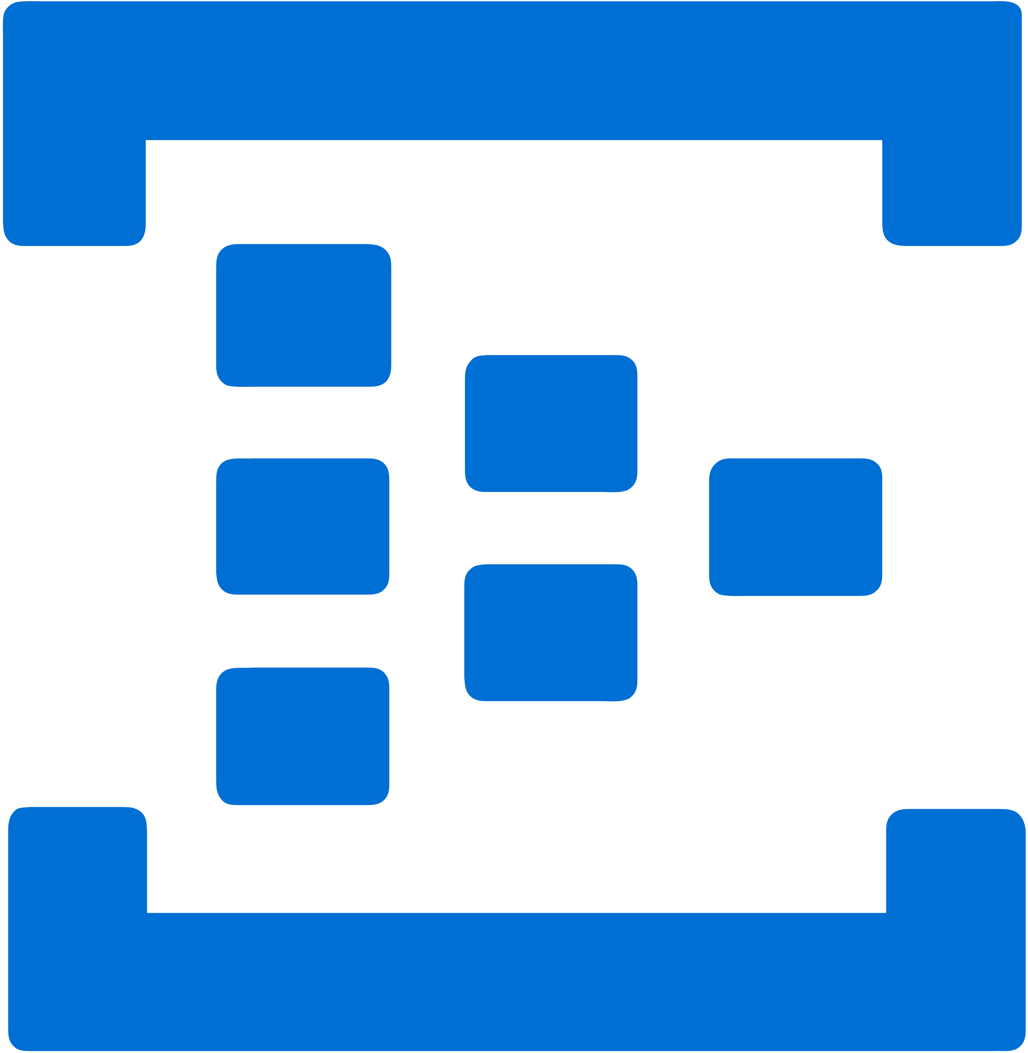
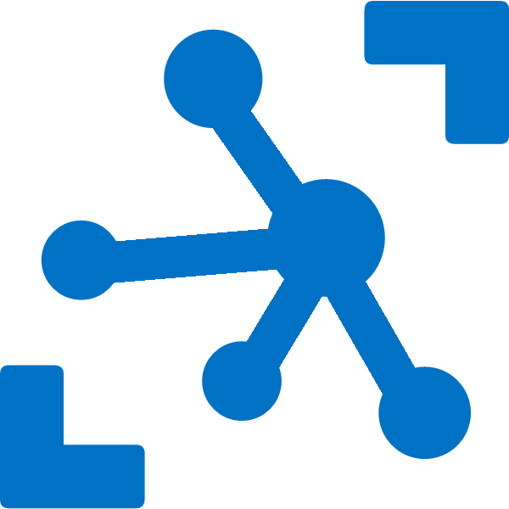
Event Hubs on Azure Stack​
IoT Hub on Azure Stack​
Build stream processing solutions on-premises​
Deploy event-driven solutions on-premises​
Easily tier data across clouds​
Have one operating model on Azure Stack and on Azure​
Establish bi-directional communication with your IoT devices on-premises
Enhance security with per device authentication
Provision devices at scale w/IoT Hub Device Provisioning Service
Manage devices at scale with device management
Multi-language and open source SDKs

Slide 24

Azure Sphere
New Azure Sphere OS secured by Microsoft for the devices 10-year lifetime to create a trustworthy platform for new IoT experiences
New Azure Sphere certified MCUs, from silicon partners, with built-in Microsoft security technology provide connectivity and a dependable hardware root of trust.
The Azure Sphere Security Service guards every Azure Sphere device; it brokers trust for device-to-device and device-to-cloud communication, detects emerging threats, and renews device security.

Slide 25
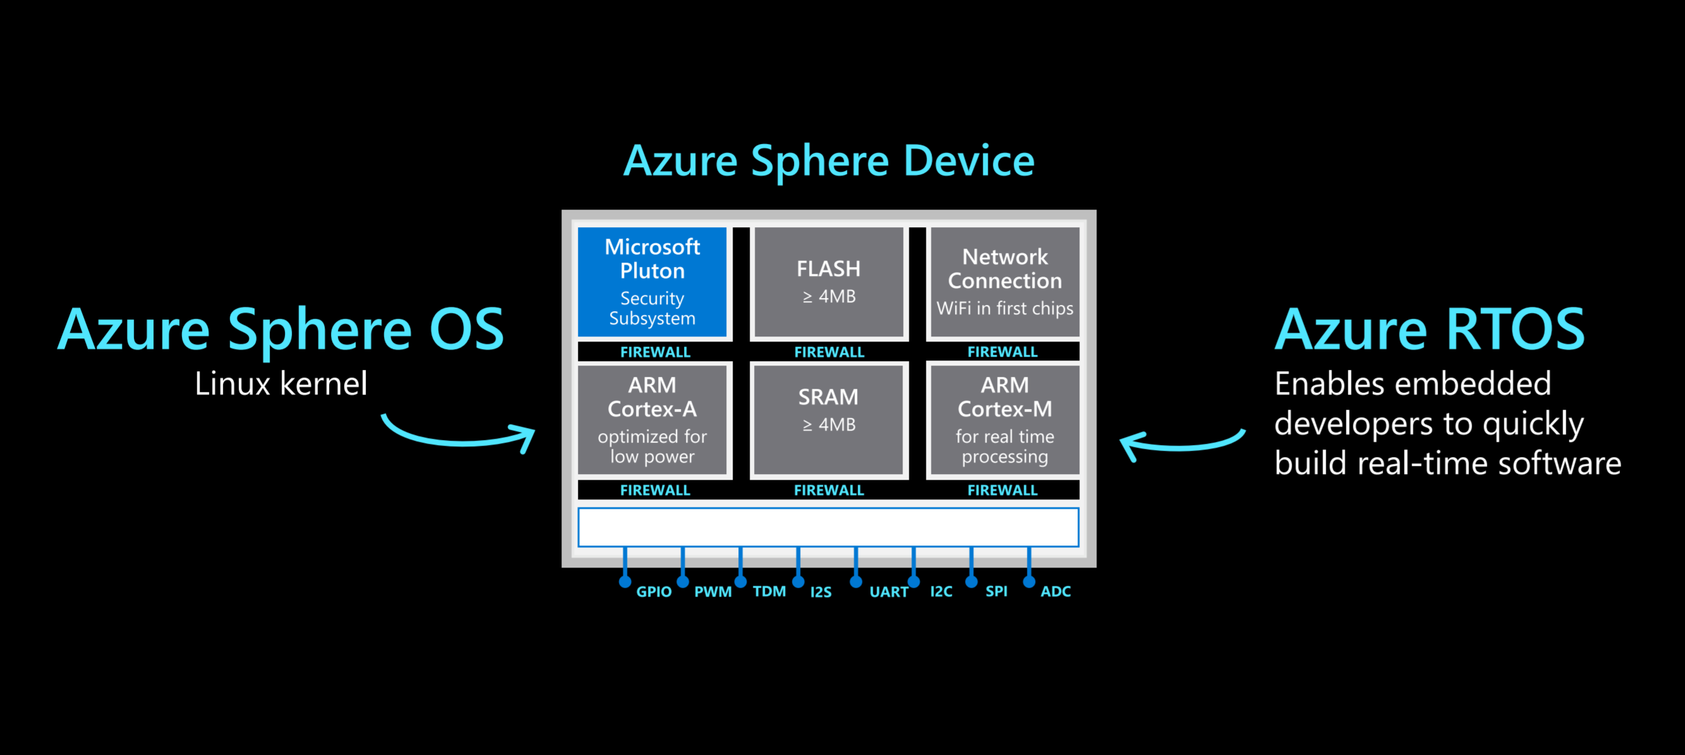
Azure Sphere & Azure RTOS

Slide 26



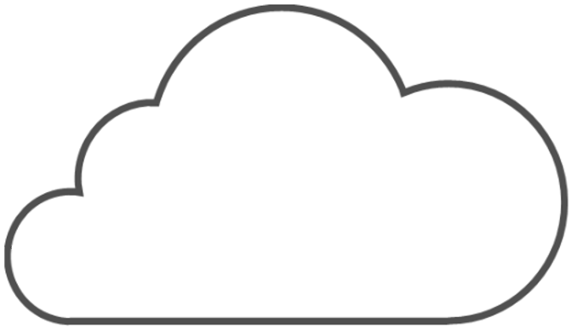

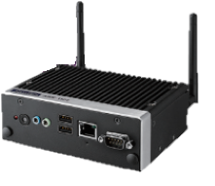
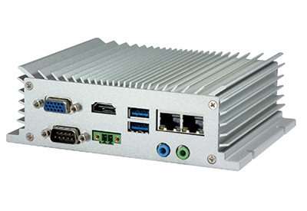
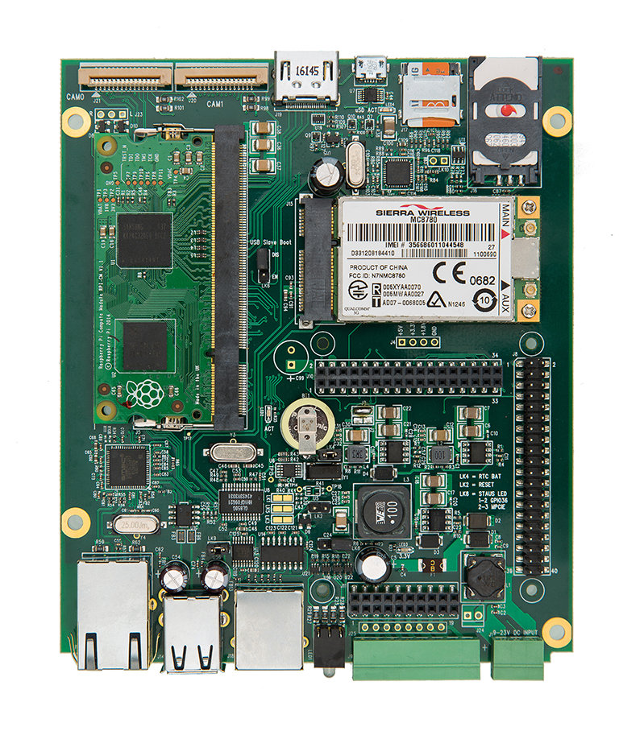
Azure IoT Edge
IoT Edge Modules
Run Azure services directly on any device. AI, Azure ML, Stream Analytics, Functions, SQL or bring your own code
Azure IoT Edge Device
Telemetry
Insight
Action
Secure
Designed for security from the ground up & only secure devices get certification
Azure IoT Edge Runtime
Open Source & Cross Platform
Open source and supports Linux, Windows and an expanding set of OS’s
IoT Hub
Cloud Managed
Remotely configure, update, monitor and manage IoT Edge devices

Slide 27
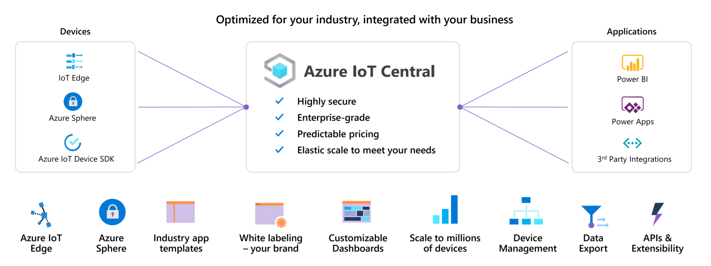
Azure IoT Central
A fully managed IoT app platform

Slide 28

Azure Defender for IoT (formerly known as Azure Security Center for IoT)
CyberX is now integrated
New agentless capabilities for unmanaged Operational Technology (OT) devices
Asset discovery, vulnerability management & continuous threat monitoring
Single solution for managed & unmanaged devices
Zero performance impact
Continued support for air-gapped environments

Slide 29
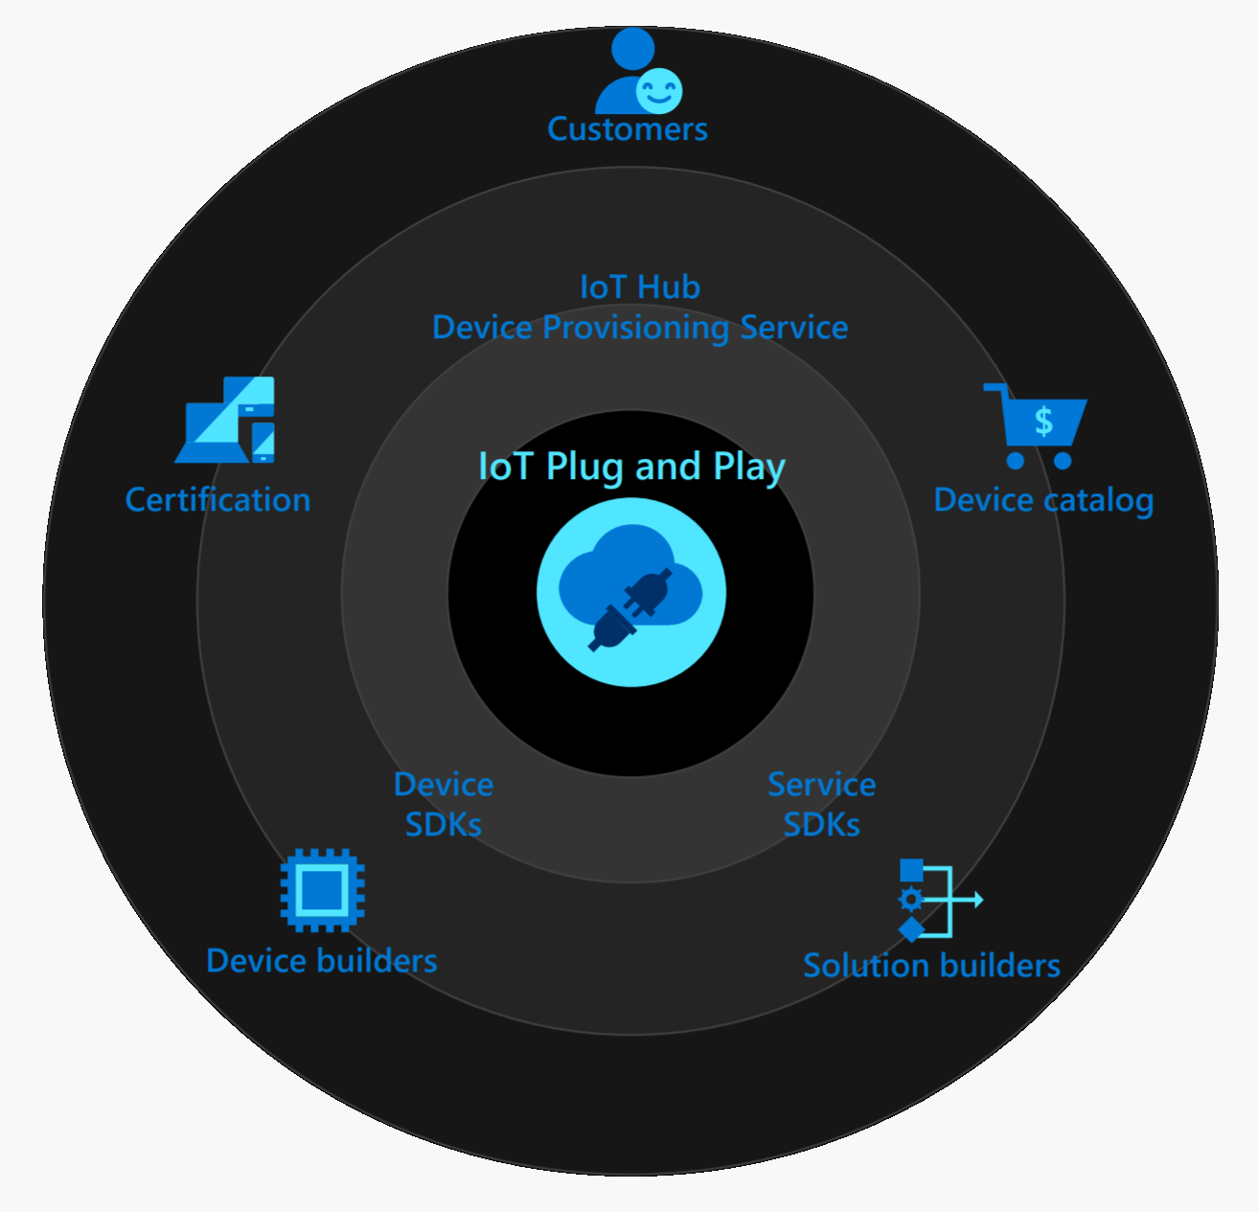
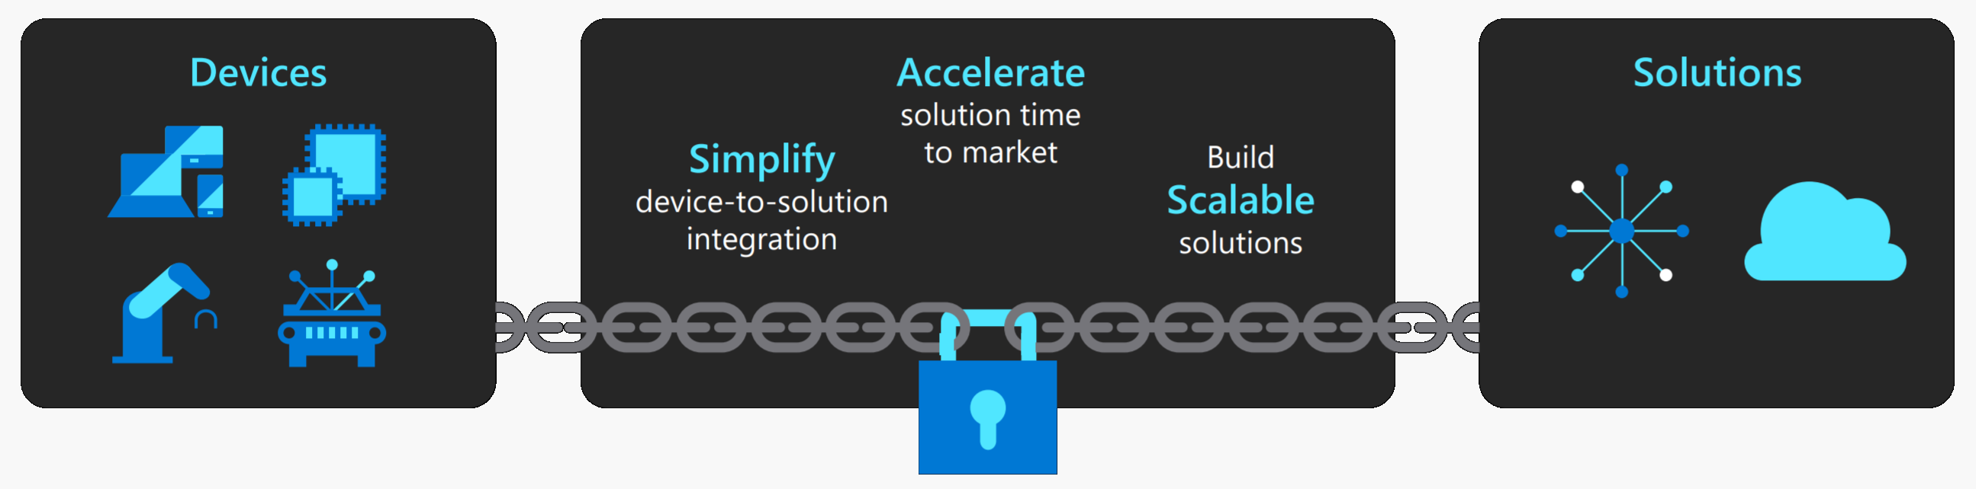
Azure IoT Plug and Play
Simplifies device interactions in IoT solutions with an open modeling language

Slide 30
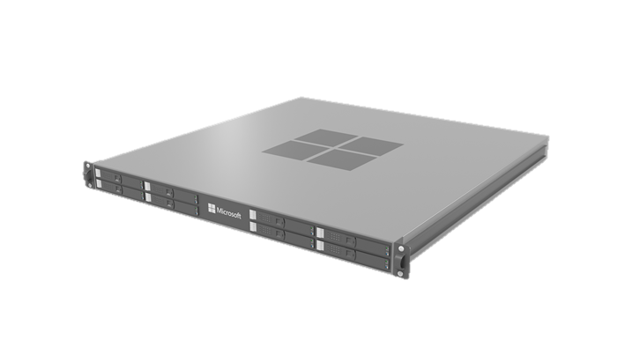
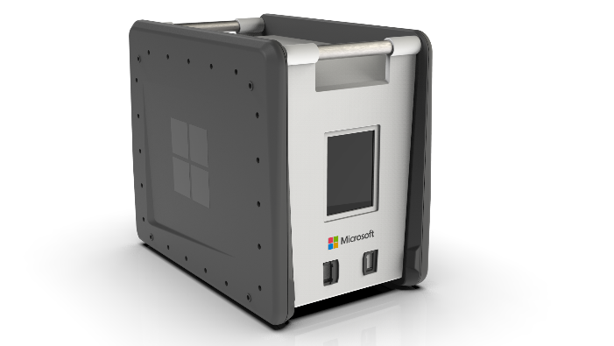
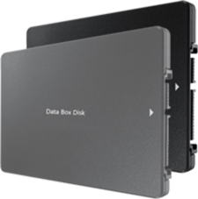
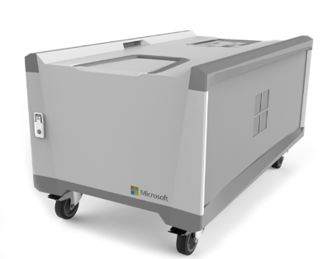
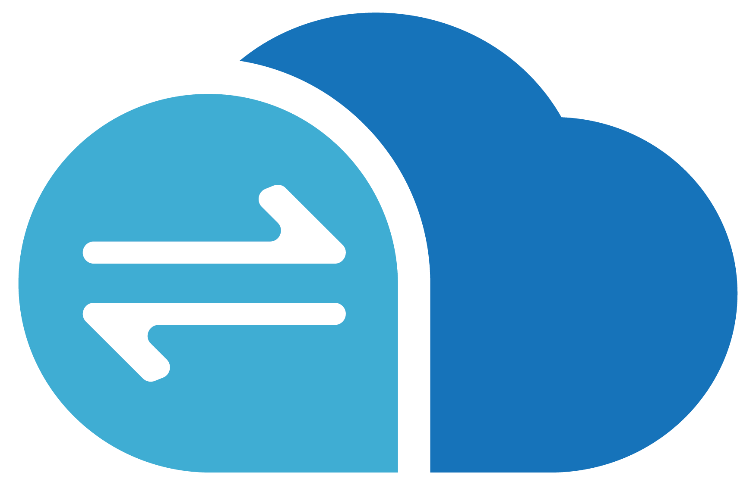
Azure Data Box Family
Transfer via shipping
Transfer via network
Data Box
Secure, ruggedized data transport appliance.
Capacity: 100 TB;
Size: ~50 lbs
Data Box Disk
Secure, ruggedized USB drives which can be ordered in packs of 5
Capacity: 8 TB disks up to 40 TB per order
Data Box Heavy
Large-scale, secure, ruggedized appliance
Capacity: 1 PB;
Weight 500+ lbs
Targeted to very large data sets
Data Box Gateway
Virtual network transfer appliance
Runs as a VM on choice of hardware
Stack Edge
(Data Box Edge)
Rack-able data transfer appliance with compute
AI-enabled compute to analyze, transform, and pre-process data before the transfer
Local Cache: ~12 TB
Includes Data Box Gateway and Azure IoT Edge

Slide 31
Azure Stack Edge
Transfer data over network to Azure
Transfer data to Azure to enable further compute and analytics or for archival purposes
Preprocess data
Transform data before sending it to Azure to create a more actionable dataset
Inference with Azure Machine Learning
Run ML models to get quick results that can be acted on before the data is sent to the cloud
An AI-enabled edge computing appliance with network data transfer capabilities
Microsoft Appliance
Acquire and manage directly from the Azure portal as part of a monthly meter

Slide 32
Emerging Connected Environments

Slide 33
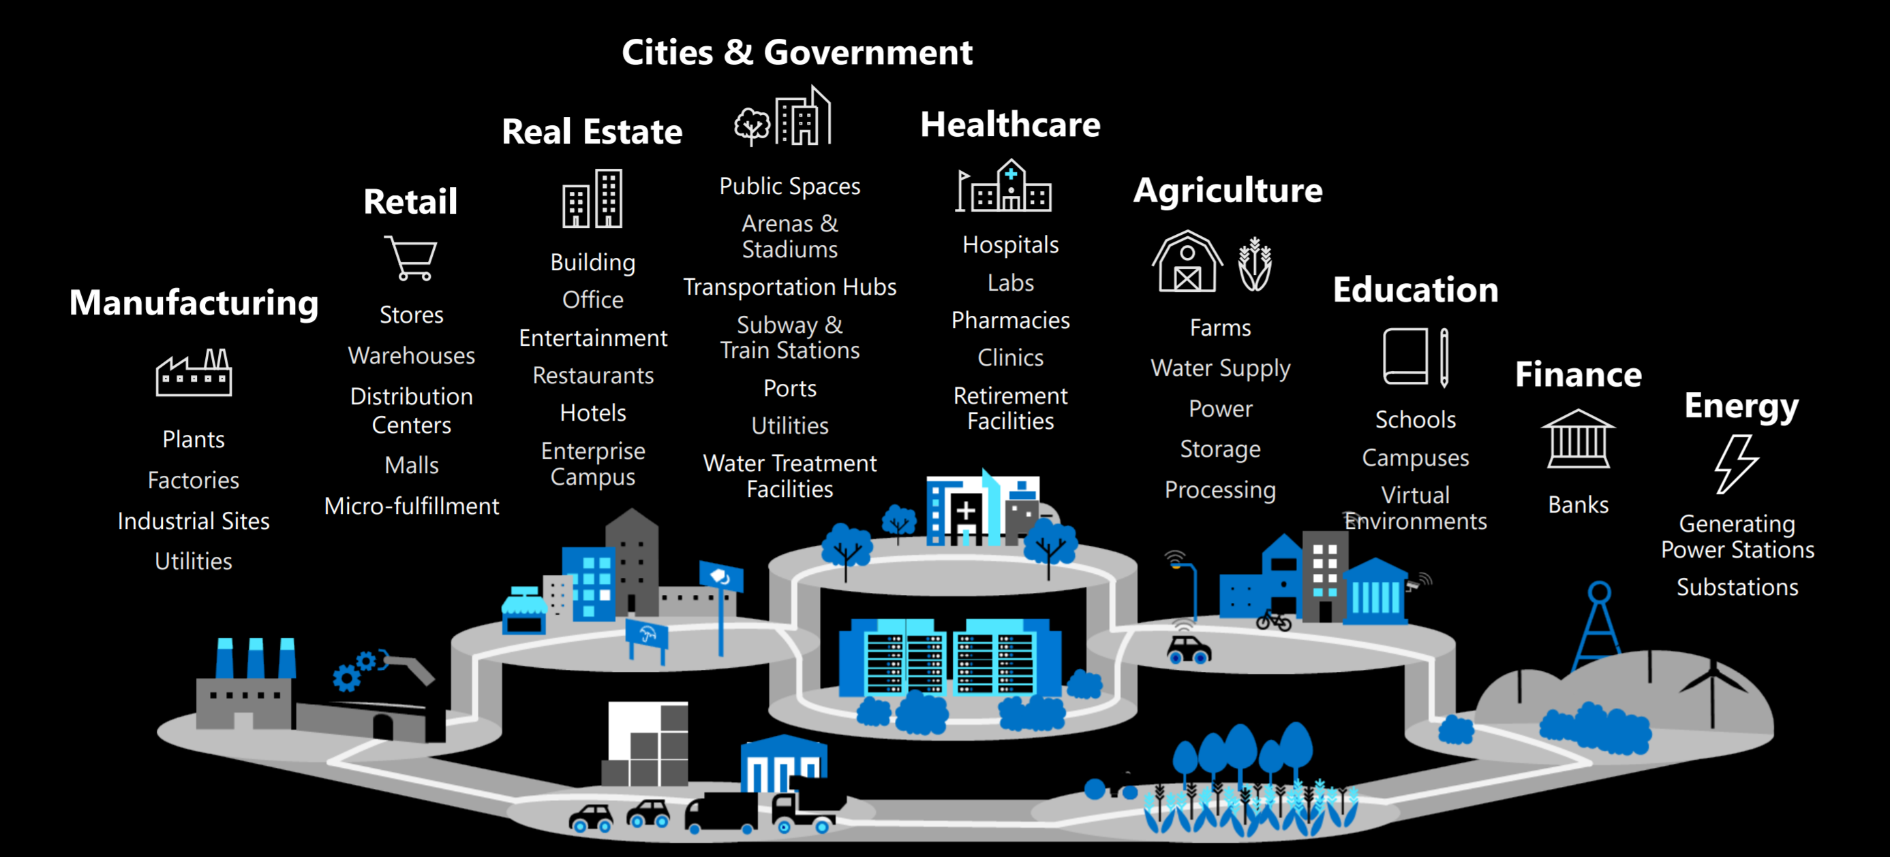
Connected Environments

Slide 34
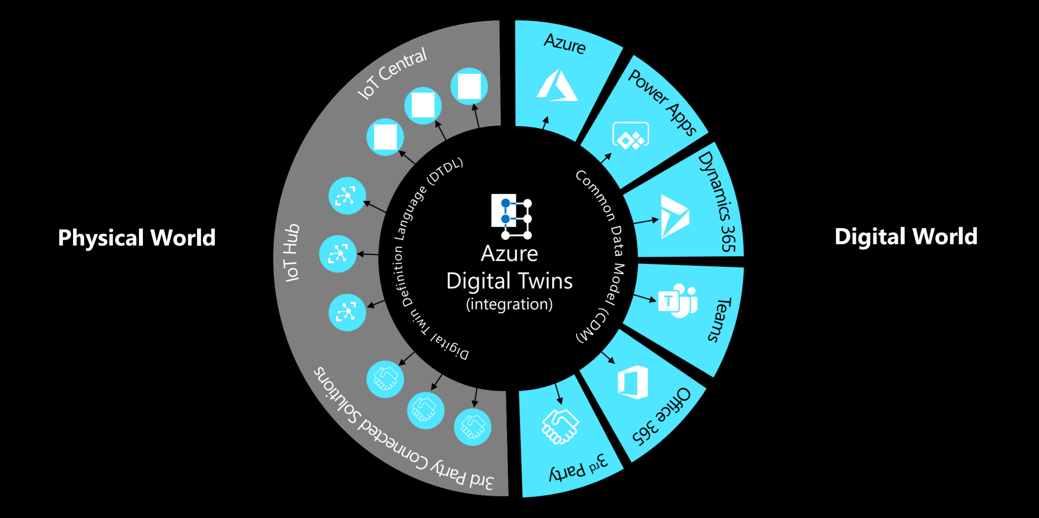
Connected Environments that reflect the Physical and the Digital

Slide 35
IoT Scenarios

Slide 36
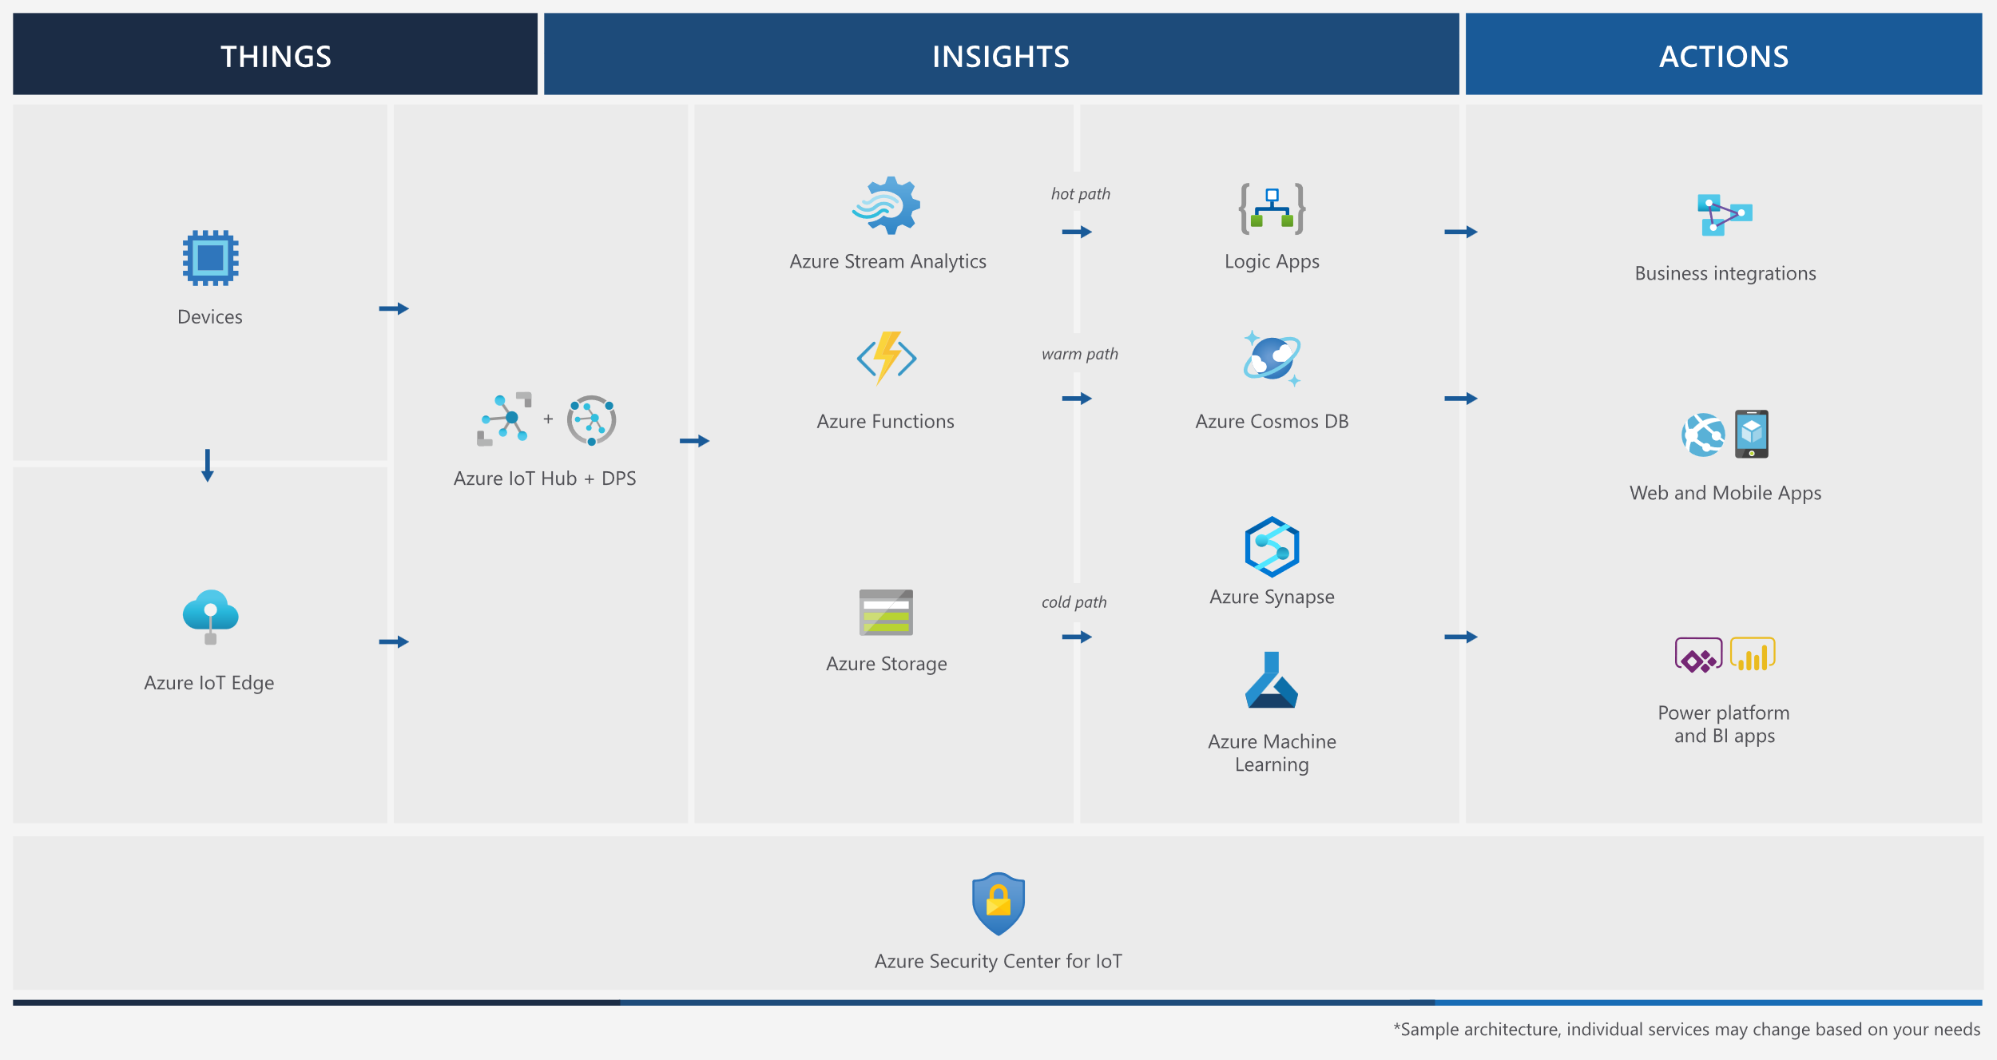
Reference Architecture

Slide 37
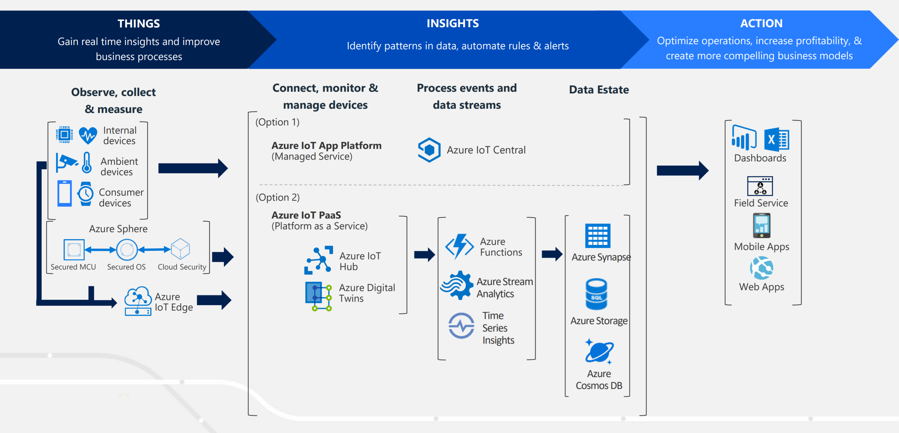
Options for building IoT Solutions

Slide 38
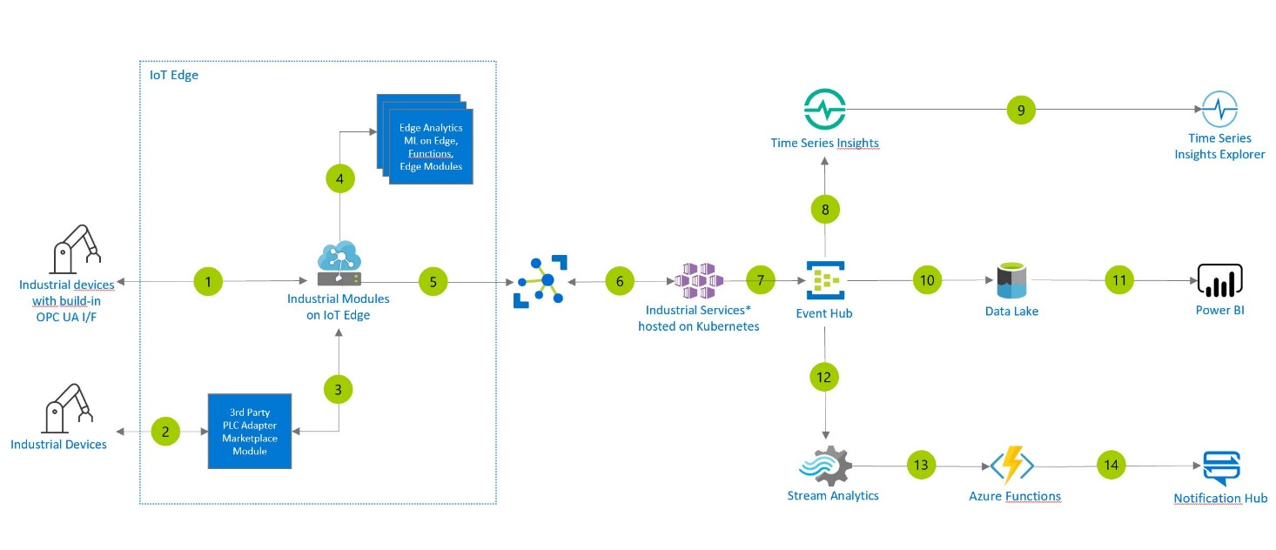
Scenario: Condition Monitoring

Slide 39
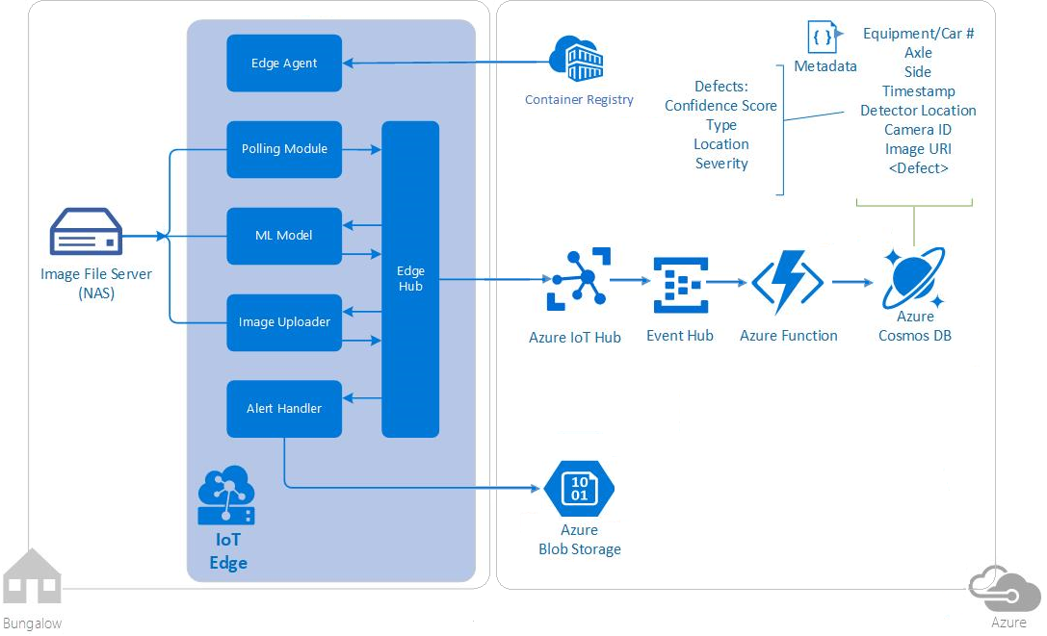
Scenario: Predictive Maintenance

Slide 40
Day 4 – We are here
Timeframe | Activity | Engagement
7:30 – 8:00 | Virtual check-in
8:00 – 9:00 | IoT Fundamentals in Azure
9:00 – 11:15 | WDS: IoT and the Smart City | Interactive Discussion
11:15 – 12:00 | Lunch
12:00 – 14:00 | Team Challenge: IoT and the Smart City PoC | Interactive Discussion | Hands-on
14:00 – 14:15 | Wrap Up the Day

Slide 41
Next: Whiteboard Design Session
GitHub repo for the Whiteboard Design Session:
https://github.com/solliancenet/cloud-core-2020
The WDS material is found under data-ai/day-4/wds

Slide 42
Day 4 – We are here
Timeframe | Activity | Engagement
7:30 – 8:00 | Virtual check-in
8:00 – 9:00 | IoT Fundamentals in Azure
9:00 – 11:15 | WDS: IoT and the Smart City | Interactive Discussion
11:15 – 12:00 | Lunch
12:00 – 14:00 | Team Challenge: IoT and the Smart City PoC | Interactive Discussion | Hands-on
14:00 – 14:15 | Wrap Up the Day

Slide 43
Day 4 – We are here
Timeframe | Activity | Engagement
7:30 – 8:00 | Virtual check-in
8:00 – 9:00 | IoT Fundamentals in Azure
9:00 – 11:15 | WDS: IoT and the Smart City | Interactive Discussion
11:15 – 12:00 | Lunch
12:00 – 14:00 | Team Challenge: IoT and the Smart City PoC | Interactive Discussion | Hands-on
14:00 – 14:15 | Wrap Up the Day

Slide 44
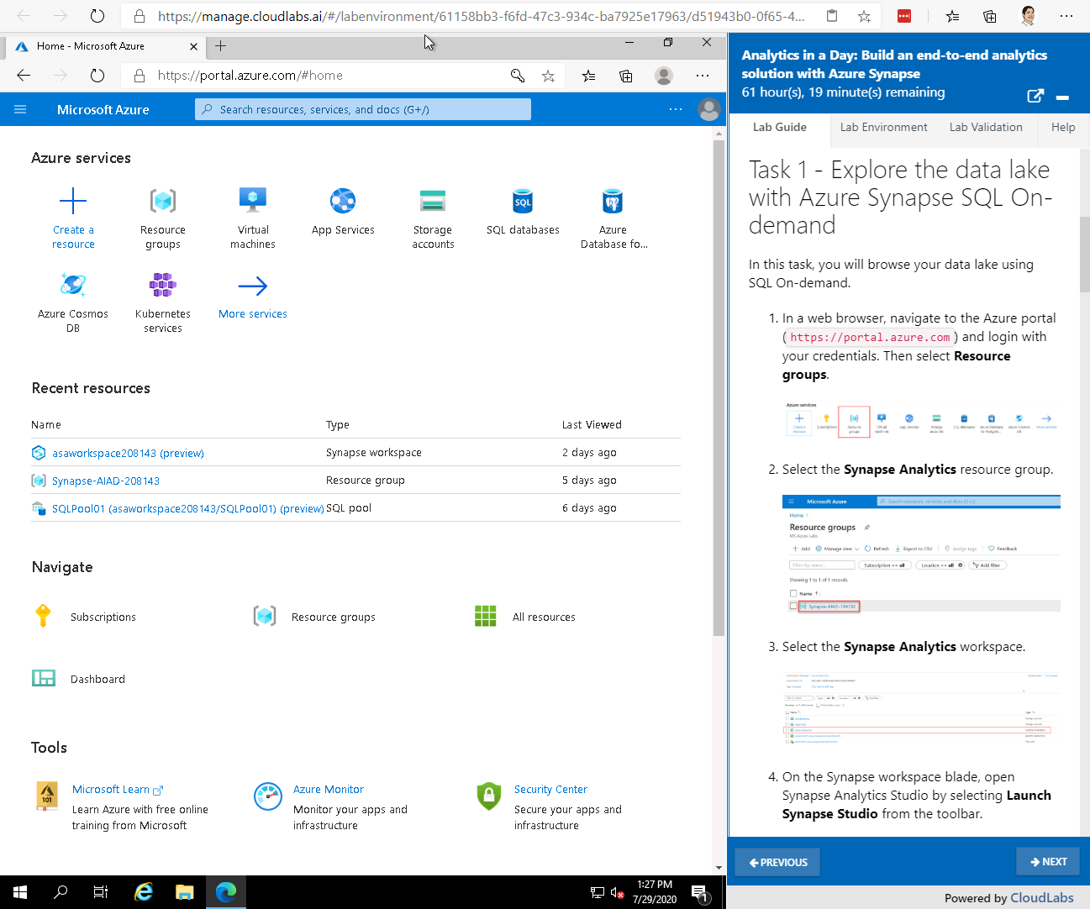
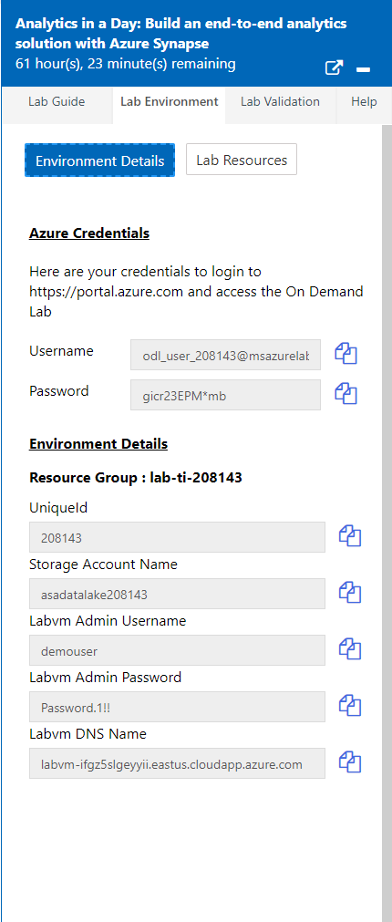
Next: Lab Experience
Lab can provide a VM with software preinstalled
Each attendee has a dedicated lab environment:
https://manage.cloudlabs.ai/#/odl/6029acfe-d79e-4077-b8cb-96c44626ce0a/79d95799-89dd-469b-b2eb-ef92fbd531ad
Lab Guide is in markdown
and pulled from GitHub
Each link is unique to the attendee.
GitHub repo for the lab:
https://github.com/solliancenet/cloud-core-2020
The challenge guide is found under data-ai/day-4/challenge
Azure credentials and other environment details in Lab Environment tab

Slide 45
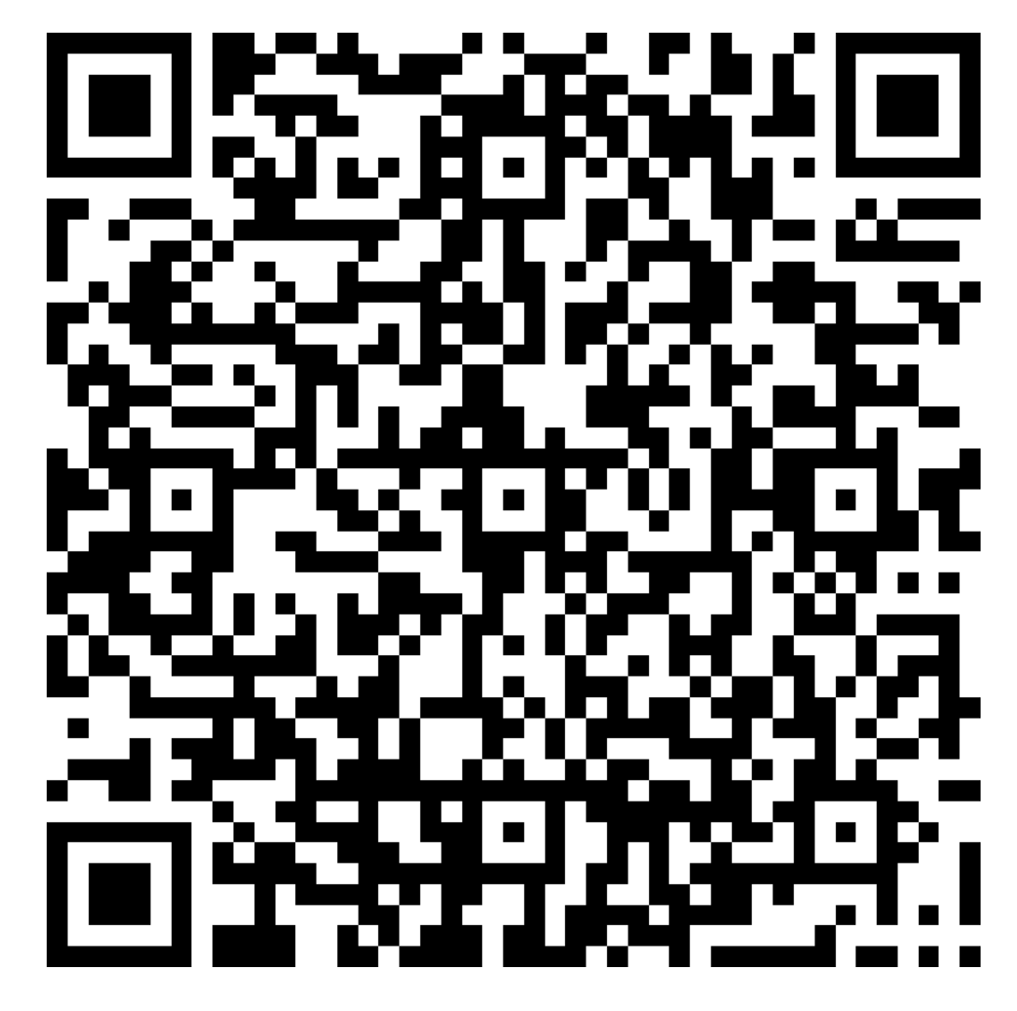
Survey

